Slide 1
Taxes
The Internal Revenue Service (IRS) is the federal agency responsible for collecting taxes

Slide 2
Types of Taxes
Income Taxes: tax on income
Personal Income: income people receive from all sources
Disposable Income: money you have left after paying income and other taxes
Progressive Tax: one in which the tax rate goes up as taxable income rises (also known as graduated tax)

Slide 3
Social Security Tax: Federal taxes that people pay while they are working so that they can receive monthly checks after they retire
Sales Tax: tax you pay when you buy goods and services

Slide 4
Property Tax: tax based on the value of your property
Excise Tax: Federal or State tax on certain goods and services such a liquor, tobacco, and gasoline

Slide 5
Estate (Death) Tax: tax on the value of the money and property a person leaves behind after dying
Gift Tax: tax on gifts to individuals that exceed a certain value, so that the elderly won’t give all their money away so that they would be able to avoid the Estate Tax

Slide 6
Filing Federal Income Tax Returns
Employers deduct money from their employees’ checks on the basis of the employees’ W-4 forms.
Each January, employers are required to send each employee a W-2 form.

Slide 7
Exemption: a set amount of money that’s not taxed
Dependent: a person who is supported by a taxpayer
Deduction: personal expense that can be subtracted from your income before figuring tax

Slide 8
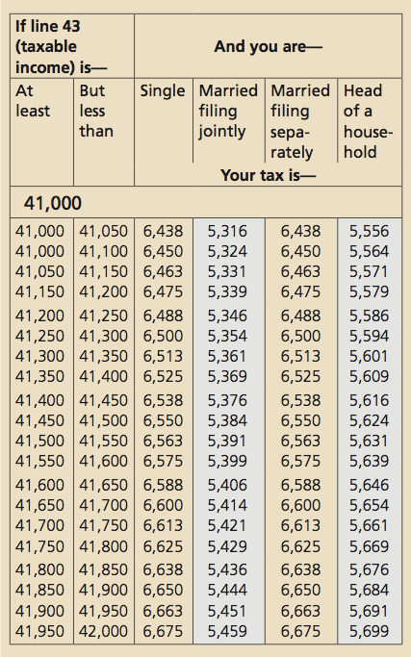
Sample Tax Table (Tax Year 2010)

Slide 9
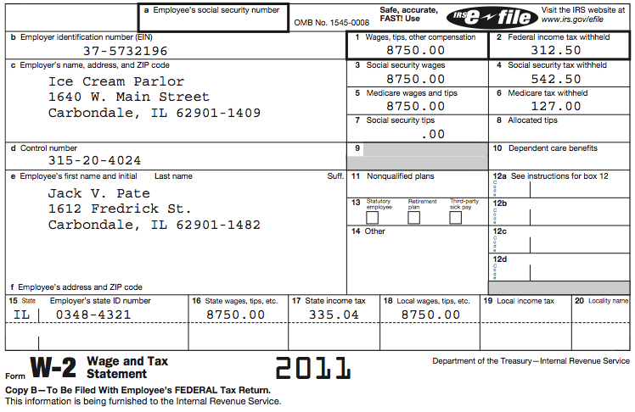
Form W-2 Wage and Tax Statement

Slide 10
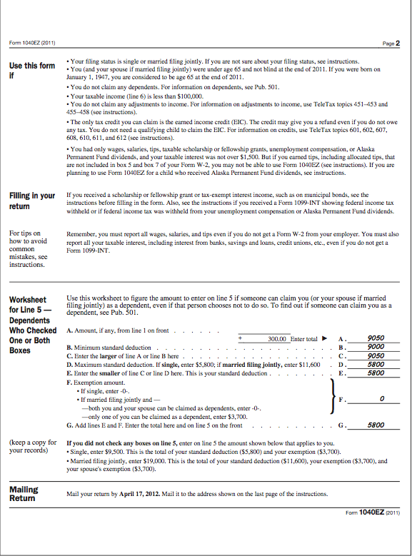
Form 1040EZ (page 2)

